Slide 1
Digital Portfolio
STUDENT NAME: SWETHAA SRI.S
REGISTER NO AND NMID: 2428b0250 AND 88378DC06878447B5044C62362558956
DEPARTMENT: BSC. COMPUTER SCIENCE WITH DATA ANALYTICS
COLLEGE: COLLEGE/ UNIVERSITY: TIRUPPUR KUMARAN COLLEGE FOR
WOMEN/ BHARATHIYAR UNIVERSITY

Slide 2
PROJECT TITLE
MY DIGITAL PORTFOLIO

Slide 3


AGENDA
Problem Statement
Project Overview
End Users
Tools and Technologies
Portfolio design and Layout
Features and Functionality
Results and Screenshots
Conclusion
Github Link
3/21/2024 Annual Review

Slide 4

PROBLEM STATEMENT
Despite advances in women’s healthcare, many gynaecological conditions remains underdiagnosed, undertreated, or poorly managed due to a combination of limited awareness, delayed reporting, socio-cultural stigma, and inadequate access to specialized care. Common issues such as menstrual disorders, polycystic ovarian syndrome (PCOS), infertility, endometriosis and reproductive cancers often go to undetected until complications arise. There is a pressing need to enhance early diagnosis, improve patient education and implement more effective, personalized treatment strategies to ensure better reproductive health outcomes for women across all age group

Slide 5

PROJECT OVERVIEW
This project aims to enhance the early detection, diagnosis and management of common gynaecological conditions among women of reproductive and post-reproductive age. Through a combination of clinical evaluation, patient education, community outreach, and the integration of evidence-based treatment protocols, the project seeks to improve women’s reproductive health outcomes. Special focus is placed on addressing challenges such as late diagnosis, limited access to specialist care, and the social stigma surrounding gynaecological issues.

Slide 6
Key Objectives
Promote awareness and early screening for gynaecological disorders (e.g., PCOS, endometriosis, cervical cancer).
Improve access to gynaecological services in underserved populations.
Standardize diagnostic and treatment protocols.
Empower patients through education and counselling.
Utilize data to track outcomes and inform future inventions.

Slide 7

WHO ARE THE END USERS?
Women of reproductive age
Individuals seeking care for menstrual health, contraception, fertility and general reproductive well-being.
Pregnant women
Patients requiring parental, perinatal, and postnatal care and monitoring.
Adolescents
Young females needing education and early intervention for menstrual and hormonal issues.
Postmenopausal women
Individuals managing menopause-related symptoms, osteoporosis.

Slide 8
Couples Fertility Support Patients undergoing evaluation or treatment for infertility Healthcare Providers General physicians, nurses, and midwives who collaborate with gynaecologists for referrals and shared care. Public Health Agencies/NGOs Organizations involved in women’s health initiatives, screenings and awareness campaigns.

Slide 9

TOOLS AND TECHNIQUES
Ultrasound
For visualizing reproductive organs, monitoring
Pregnancy, and detecting abnormalities.
Pap Smear & HPV Testing
For cervical cancer screening.
Colposcopy
To examine the uterine cavity for abnormalities
Such as fibroids or polyps.

Slide 10
Laparoscope . For minimally invasive surgeries such as cyst removal, tubal ligation, and endometriosis treatment. Electrosurgical Instruments . For procedures like LEEP(Loop Electrosurgical Excision Procedure). Dilation and Curettage(D&C) Tools . For diagnosing or treating uterine conditions. Cryotherapy Equipment . For treating precancerous cervical lesions.

Slide 11
POTFOLIO DESIGN AND LAYOUT
Header section
This contains the main navigation bar
The navigation links users jump to various sections of the page.
We can add name or logo in this section for branding.
About me
This section introduces the gynaecologists, including the brief biography
and an of image.
Services
This section displays the services offered by the gynaecologist in a
grid layout.
11

Slide 12
Qualifications
Highlights your educational background, training, and any specializations such as a Fellowships in Laparoscopic surgery or advanced degrees like MD in Obstetrics and Gynaecology.
A Flexbox layout is used to display these qualifications in a responsive card format.
Contact
Provides multiple ways for patients to contact you: email, phone, clinic address, and links to LinkedIn and Instagram Profiles for a more personal or professional connection.
This section makes it easy for potential patients to reach out for appointments or inquiries.

Slide 13
FEATURES AND FUNCTIONALITY
User-Friendly Navigation
Function: Easy and intuitive navigation to different sections of the portfolio.
Functionality: A sticky menu or fixed navigation bar that allows quick access to essential sections like About Me, Services, Testimonials, contact, etc.
About Me
Function: introduces the gynaecologist and their qualifications.
Functionality: A personal bio section with the gynaecologists education, certifications, and professional photo adds credibility.

Slide 14
Services Provided Function: Showcase the services offered by the gynaecologist. Functionality: Detailed sections of subsections that describes services like routine exams, prenatal care, menopause management, fertility consultations, and surgical procedures. This can also include interactive icons or images representing each services. Patient Testimonials . Function: Build trust and establish credibility. Functionality: Display real patient testimonials in a dedicated section. You could use quotes, patient names and possibly photos to give it to a personal touch.

Slide 15
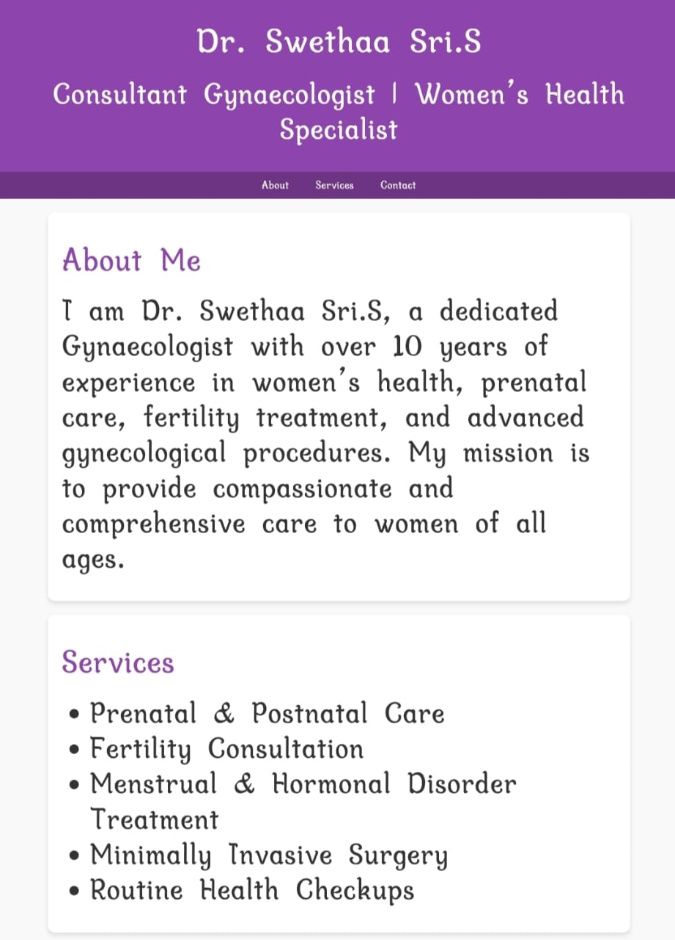

RESULTS AND SCREENSHOTS
3/21/2024 Annual Review
15

Slide 16
CONCLUSION
My career as a gynaecologist has been driven
By a passion for women’s health and a
Commitment to providing compassionate, evidence-based care.
Through years of clinical practice and patient interactions, I have refined my skills in diagnosing, treating, and supporting women
At all life stages. I strive to empower my patients with knowledge, helping them make informed decisions about their health. Ongoing professional development remains a cornerstone of my practice, ensuring I stay current with medical advancements. My approach prioritizes empathy, respect, and individualized care. I am dedicated to promoting well-being and improving outcomes for every patient. Ultimately, my goal is to provide comprehensive care that enhances the health and quality of life of the women I serve.
16

